Slide 1
2024 Second Quarter Outlook:
Stocks Spring Forward
<Enter Date>
--Rep Name
--Firm-Approved Title
--Registered Branch Address
--Approved Email and/or Registered Phone
--Securities Disclosure
Enter all information and submit to Ad Review for final approval
Notes:
Intro

Slide 2
Investment Themes
Three Themes in 2024 Market Outlook – Still Intact
Fed Goes From Foe to Friend
Economy Cooling into a Soft Landing
Market Volatility Will Provide Opportunities
Notes:
Where we stand now in the 2024 outlook.

Slide 3
Fed Goes From Foe to Friend
Notes:
First Theme: In tact but delayed

Slide 4
Inflation Optimism Hits A Bump in the Road
Notes:
In looking at the economy, let’s first start with the Fed’s main concern now: inflation. Heading into the year, inflation seemed under control, but the Fed was reluctant to wave the victory flag. Annualizing inflation data from July to December, the inflation rate, as measured by the Fed’s favorite inflation metric, the core Personal Consumption Expenditure Price Index (Core PCE Price Index) was running under the Fed’s 2% target. The 12-month rate was still around 3%, but that was being dragged higher from the first six months of the year when inflation was running hotter.
January, however, provided some inflation surprises that somewhat justified the Fed’s wait-and-see approach. For the month, inflation exceeded economist expectations and the six-month annualized inflation rate jumped to around 2.5% and above the Fed’s target. However, since January 2023 inflation was higher, the 12-month inflation rate eased slightly. Regardless, January proved inflation may be more stubborn than investors had hoped. On top of that, the consumer price index (CPI) and the producer price index (PPI) indicated that inflationary pressures were elevated in February, as well.

Slide 5
January Inflation Bump
Notes:
We would caution putting too much weight into the January data, however. Economic data is very hard to adjust for seasonality as the U.S. economy is over $20 trillion. A large part of inflation data is related to rental costs, which are largely estimated based on the amount a homeowner can rent their primary residence (owners’ equivalent rent). It is a somewhat hypothetical inflation figure and in January this figure deviated substantially from inflation seen in actual rentals of primary residences. February saw owners’ equivalent rents ease, but we didn’t see as large of a reversal as expected. Regardless, with newly listed rental properties showing modest weakness, we expect rent inflation to eventually slow.

Slide 6
Inflation Excluding Shelter
Notes:
While we got some inflation surprises in the first part of the year, we still anticipate the Fed cutting rates, possibly as early as June. If we strip out shelter costs, such as owners equivalent rent, the 12-month CPI is under 2% as of February (PCE for February doesn’t get released until the end of March). Investors in the futures market have currently priced the probability of a June rate cut at just over 50%.

Slide 7
Interest Rates Are Real
Notes:
The Fed Funds rate is restrictive at current levels. If we compare it to core CPI, you can see it is over 1.5% higher than that inflation metric. This is welcomed news to savers on fixed incomes, but it illustrates the ability for the Fed to cut rates. The Fed Funds rate minus inflation or real rate has not been this high since before the financial crisis around 15 years ago.

Slide 8
Economy Cooling into a Soft Landing
Notes:
While the Fed is restrictive, the economy has been resilient.

Slide 9
The Other Dual Mandate
Notes:
The labor market is showing signs of moderating, but at current levels there are no recessionary signs. The unemployment rate has been under 4% for 25 consecutive months through February, something that hasn’t happened since the 1960s. If people have jobs and are making money, they should continue to spend that money. The U.S. is predominantly a consumer-driven economy, so this is important. The unemployment rate does tend to bottom out prior to a recession, but with current labor shortages in certain sectors of the economy, hopefully this is not the case and rising unemployment from low levels could just be a sign the economy is normalizing from the pandemic economy. Furthermore, the pace of jobs growth is still healthy.

Slide 10
Consumer Spending
Notes:
This labor market translates into decent consumer spending. While slowing, it is now around pre-pandemic levels and is normalizing form the pandemic economy and all the fiscal stimulus.

Slide 11
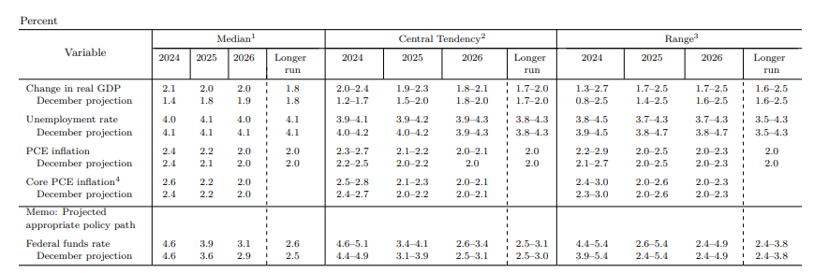
Economic Projections of Federal Reserve Board Members
Notes:
Economic growth expectations have been raised. Economists as well as the Fed are expecting economic growth to be over 2% in 2024. The Fed had projected this growth to be under 1.5% going into the year.

Slide 12
Strengthening Economy
Notes:
If we look at the Citi Economic Surprise Index, this confirms the revised forecasts. Economic data has come in better than expected thus far this year.

Slide 13
Market Volatility Will Provide Opportunities
Notes:
While the Fed cutting rates and the economy doing better than expected, we still expect volatility at some point this year.

Slide 14
Melt Up
Notes:
Stocks have pushed higher in 2024, reaching 19 new all-time highs thus far (as of this writing). In 2023, there were no new all-time highs and 2022 only saw one, which was recorded the first trading day of the year. These sorts of records do tend to come in streaks though. Prior to the recent draught, the S&P 500 hit 70 all-time highs in 2021.

Slide 15
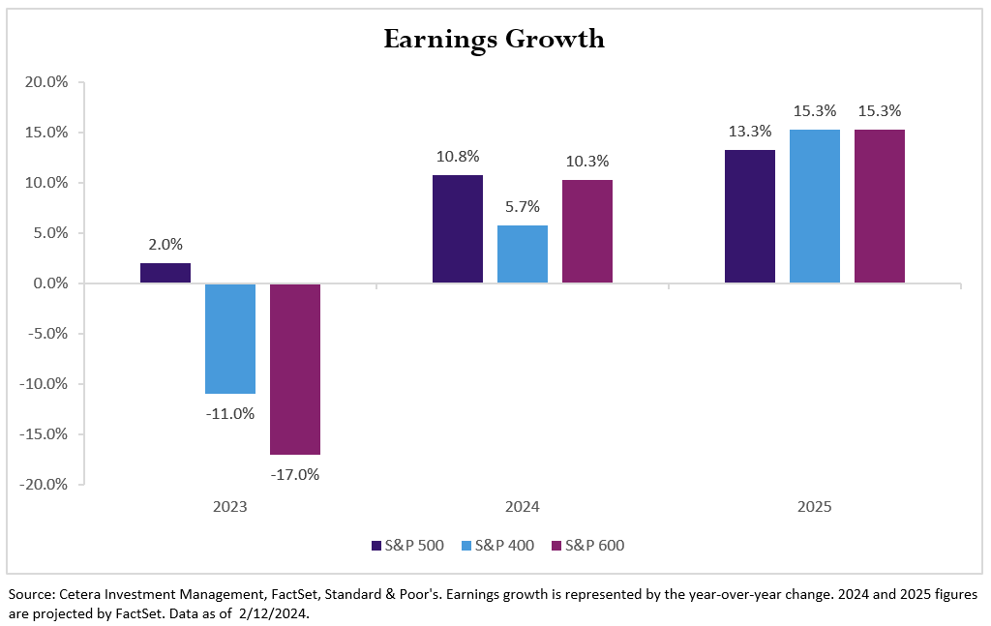
Higher Expectations
Notes:
While markets have moved higher, it has largely been a story about multiple expansion, meaning stock prices have gone higher while earnings have lagged. Earnings growth is expected to be better in the future though, which is driving the optimism. Stock markets are forward-looking, but if earnings don’t match expectations, the risk of volatility increases.

Slide 16
Valuation Gap
Notes:
As such, valuations in large cap stocks are stretched relative to their long-term average. This is more pronounced for large cap growth and technology stocks, which are influenced by artificial intelligence enthusiasm, driving valuation levels to even more elevated levels.
With stock markets climbing without much pause, it would be expected that we could eventually see some pullbacks. Corrections, or 10% pullbacks in markets, are a normal part of investing. Predicting the timing is difficult, so waiting for this to occur isn’t advisable either. Diversification is the key to mitigating stock market volatility—diversifying stocks and even owning bonds where appropriate.

Slide 17
Roller Coaster Ride for Bond Yields
Notes:
Volatility isn’t confined to stocks either, as we saw last year in the bond market. This year bonds have had some steep movements up and down, but overall bonds are still mostly negative heading into the second quarter. Shorter-term bonds and high-yield bonds are the exception. High-yield bonds tend to correlate more strongly with equities. You can see the movement in the 10-year Treasury yield in this slide. Keep in mind bond yields move inversely to bond prices.

Slide 18
Savings relative to income
Notes:
The good news is that any potential pullback could provide opportunities to find good entry points into a long-term strategic investment plan. Americans have saved a lot collectively after refinancing their mortgages early in the pandemic and stockpiling stimulus money. We realize everyone’s situation is different, but in aggregate Americans’ have a high level of savings. This slide shows the amount of savings relative to disposable income, indicating we are above pre-pandemic levels. It is important to show this figure relative to something like disposable income because over time savings will grow as the economy grows. We will always be close to all-time highs for savings as inflation grows and the economy and wages expand. The savings we are referring to is in money market and bank deposits. It is possible that if we do see stock market pullback, some savings could make their way into the stock market as investors seek better entry points. There is a lot of cash on the sidelines right now, possibly waiting to be deployed.

Slide 19
.
RISKS
Economy Rolls Over (Fed Waits Too Long to Cut Rates)
1
Inflationary Pressures Reignite (Fed Cuts Rates Too Soon)
2
Geopolitical Risks
3
Frothy Large Cap Valuations
4
Notes:
The Goldilocks scenario of a resilient economy coupled with the Fed getting ready to cut interest rates is becoming more likely. This scenario isn’t set in stone, however. While everyone is discounting hotter-than-expected inflation readings, the risk of another hot reading brings more gravity. While the Fed can look past a few bad inflation reports, another one may signal a trend and not an anomaly. Additionally, there are risks in the Fed not cutting rates soon enough. Their current interest-rate policy is restrictive and could eventually cause a recession. The Fed’s optimism around the economy and inflation is also shared by investors which have pushed up stock prices with earnings yet to catch up.
This could be setting the stage for some turbulence in markets as investors recalibrate their projections and expectations. Stock markets have largely gone up with little resistance to start the year, so we would expect some pullbacks along the way. We do think any pullbacks could be short-lived and investors would be wise not trying to time them. While there are risks in the market, a lot of the optimism is warranted. We do believe inflation will continue to ease, the Fed will cut rates and the economy will remain on solid footing.

Slide 20
Thank You!
Follow Us:
@CeteraIM
Cetera Investment Management
Notes:
Thank you

Slide 21
Disclosures
About Cetera® Investment Management
Cetera Investment Management LLC is an SEC registered investment adviser owned by Cetera Financial Group®. Cetera Investment Management provides market perspectives, portfolio guidance, model management, and other investment advice that can help you advance your business and client relationships.
About Cetera® Financial Group
“Cetera Financial Group” refers to the network of independent retail firms encompassing, among others, Cetera Advisors LLC, Cetera Advisor Networks LLC, Cetera Investment Services LLC (marketed as Cetera Financial Institutions or Cetera Investors), and Cetera Financial Specialists LLC. All firms are members FINRA/SIPC. Located at 655 W. Broadway, 11th Floor, San Diego, CA 92101.
Individuals affiliated with Cetera firms are either Registered Representatives who offer only brokerage services and receive transaction-based compensation (commissions), Investment Adviser Representatives who offer only investment advisory services and receive fees based on assets, or both Registered Representatives and Investment Adviser Representatives, who can offer both types of services.
For more information about Cetera Investment Management, please reference the Cetera Investment Management LLC Form ADV disclosure brochure and the disclosure brochure for the registered investment adviser your adviser is registered with. Please consult with your adviser for his or her specific firm registrations and programs available.
No independent analysis has been performed and the material should not be construed as investment advice. Investment decisions should not be based on this material since the information contained here is a singular update, and prudent investment decisions require the analysis of a much broader collection of facts and context. All information is believed to be from reliable sources; however, we make no representation as to its completeness or accuracy. The opinions expressed are as of the date published and may change without notice. Any forward-looking statements are based on assumptions, may not materialize, and are subject to revision.
All economic and performance information is historical and not indicative of future results. The market indices discussed are not actively managed. Investors cannot directly invest in unmanaged indices. Please consult your financial advisor for more information.
Additional risks are associated with international investing, such as currency fluctuations, political and economic instability, and differences in accounting standards.
A diversified portfolio does not assure a profit or protect against loss in a declining market.

Slide 22
Glossary
The S&P 500 is an index of roughly 500 stocks chosen for market size, liquidity and industry grouping (among other factors) designed to be a leading indicator of U.S. equities and is meant to reflect the risk/return characteristics of the large cap universe.
The Russell 1000 Growth Index measures the performance of the large-cap growth segment of the U.S. equity universe. It includes those Russell 1000 Index companies with higher price-to-book ratios and higher forecasted growth values.
The Russell 1000 Value Index measures the performance of the large-cap value segment of the U.S. equity universe. It includes those Russell 1000 Index companies with lower price-to-book ratios and lower forecasted growth values.
The Chicago Board Options Exchange (CBOE) Volatility Index, commonly known by its ticker symbol VIX, is a measure of the stock market's expectation of volatility implied by S&P 500 index options.
The Bloomberg Barclays US Aggregate Bond Index is a broad based flagship benchmark that measures the investment grade, US dollar-denominated, fixed-rate taxable bond market. Eligible bonds must have at least one year until final maturity, but the index holdings have a fluctuating average life of around 8.25 years. This total return index is unhedged and rebalances monthly.
The ICE BofA US High Yield Index tracks the performance of US dollar denominated below investment grade rated corporate debt publicly issued in the U.S. domestic market. To qualify for inclusion in the index, securities must have a below investment grade rating (based on an average of Moody's, S&P, and Fitch) and an investment grade rated country of risk (based on an average of Moody's, S&P, and Fitch foreign currency long term sovereign debt ratings). Each security must have greater than 1 year of remaining maturity, a fixed coupon schedule, and a minimum amount outstanding of $100 million.
The Nasdaq Composite Index is a large, broad-based, market-cap-weighted index of more than 2,500 common equities listed on the Nasdaq stock exchange. It is often seen as a stand-in for the technology sector and its performance.

